Slide 1

Good Cabs
Affordable & Reliable Rides
Notes:
Hello everyone! Welcome to my presentation on GoodCabs Performance Analysis. GoodCabs is redefining travel in India’s tier-2 cities, offering affordable and reliable rides while supporting local drivers. Today, we’ll dive into key insights and recommendations to enhance GoodCabs’ performance and growth.

Slide 2
Table of Contents
Project Overview
Objective
Dashboard
Key Insights
Ad-Hoc SQL Report
Action Plan Next Step
Notes:
Let me give you a roadmap for this presentation. We'll cover the project overview, objectives, key insights, dashboard analysis, ad-hoc SQL reports, and finally, action plans for improvement.

Slide 3
Project Overview
Goodcabs is a growing cab service operating in ten tier-2 cities in India, dedicated to supporting local drivers and providing quality service to passengers. In 2024, the company aims to meet performance targets to drive growth and enhance satisfaction. This project will analyze key operational metrics to provide insights that will help Goodcabs optimize its operations and achieve its goals.
Notes:
GoodCabs is a growing cab service operating in 10 tier-2 cities across India. Our analysis focuses on their 2024 targets, exploring how to improve trip volumes, passenger satisfaction, and repeat rates to drive growth and ensure exceptional service.

Slide 4
Objective
The objective of this project is to analyze GoodCabs' performance across key metrics and provide actionable insights to the Chief of Operations. The focus areas for the analysis include:
Trip Volume: Measuring the total number of trips completed.
Passenger Satisfaction: Evaluating the service quality based on passenger feedback.
Repeat Passenger Rate: Analyzing the percentage of passengers who book multiple trips.
Trip Distribution: Understanding trip patterns across cities.
Passenger Demographics: Assessing the balance between new and repeat passengers.

Slide 5


Slide 6
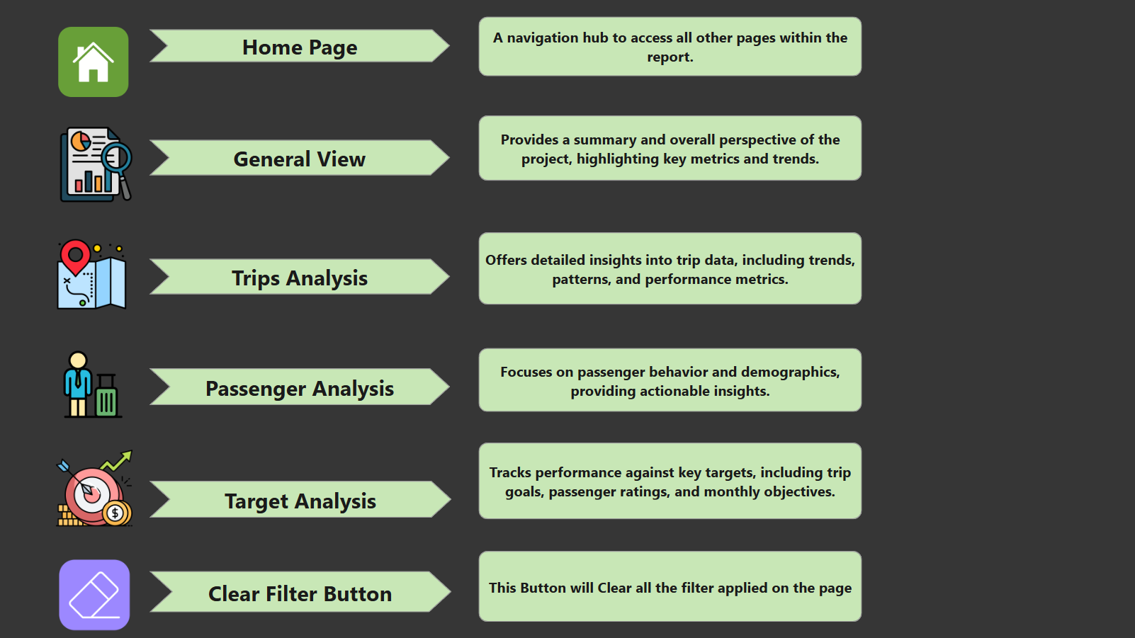

Slide 7
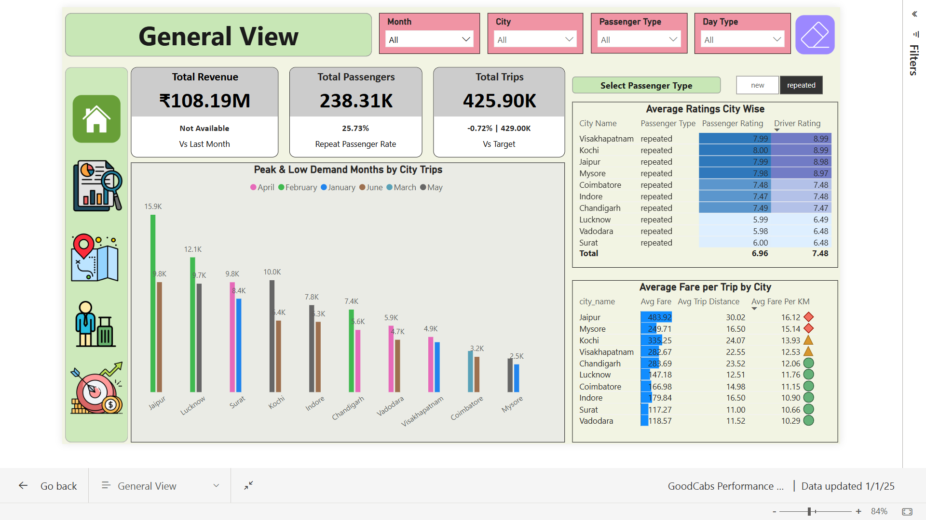

Slide 8
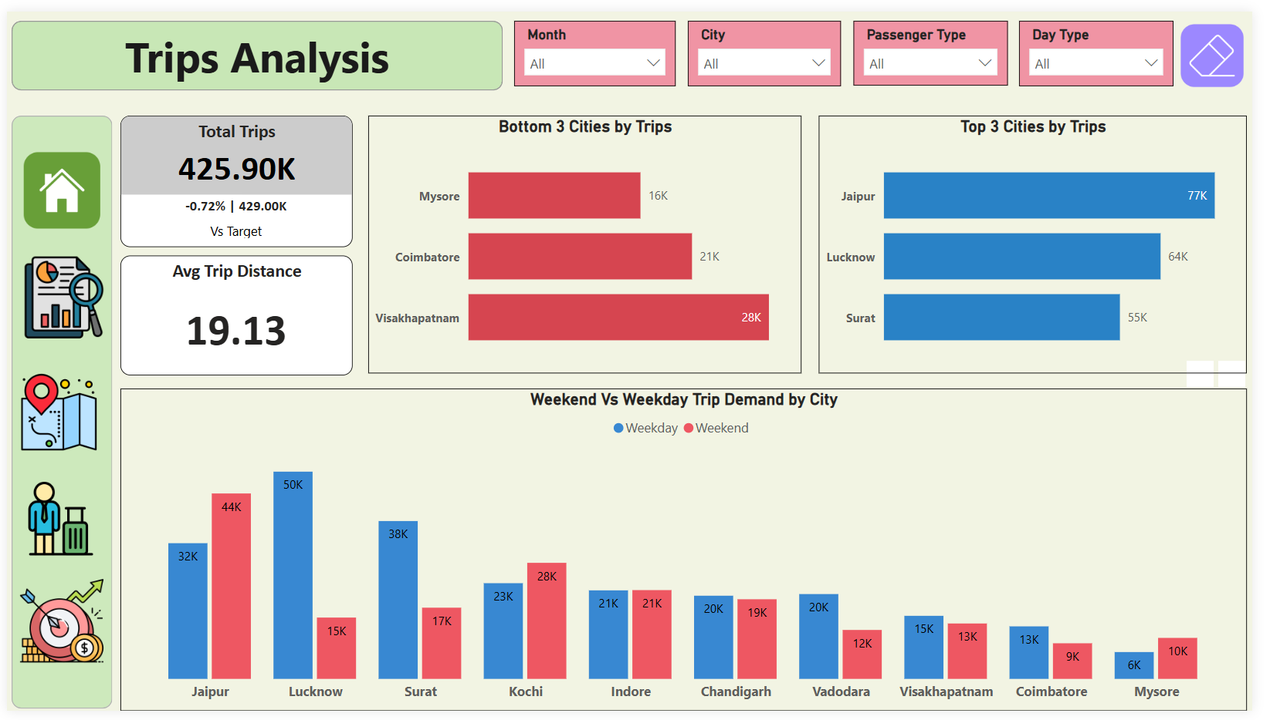

Slide 9
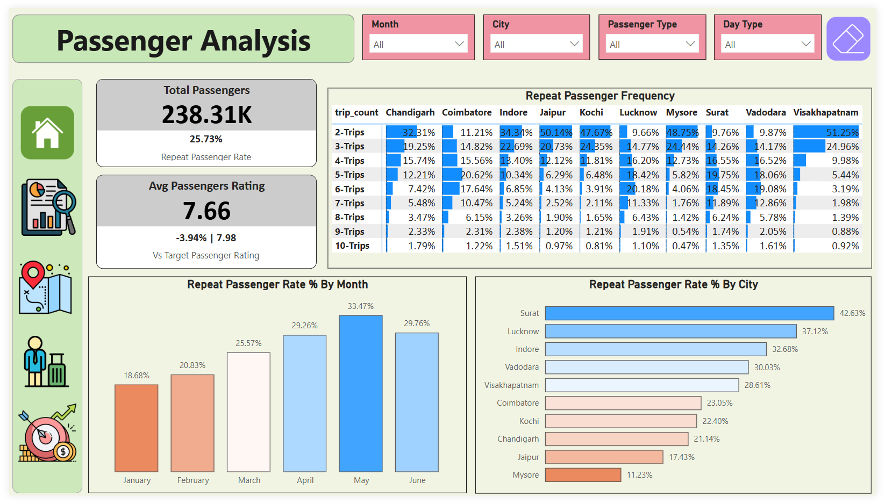

Slide 10
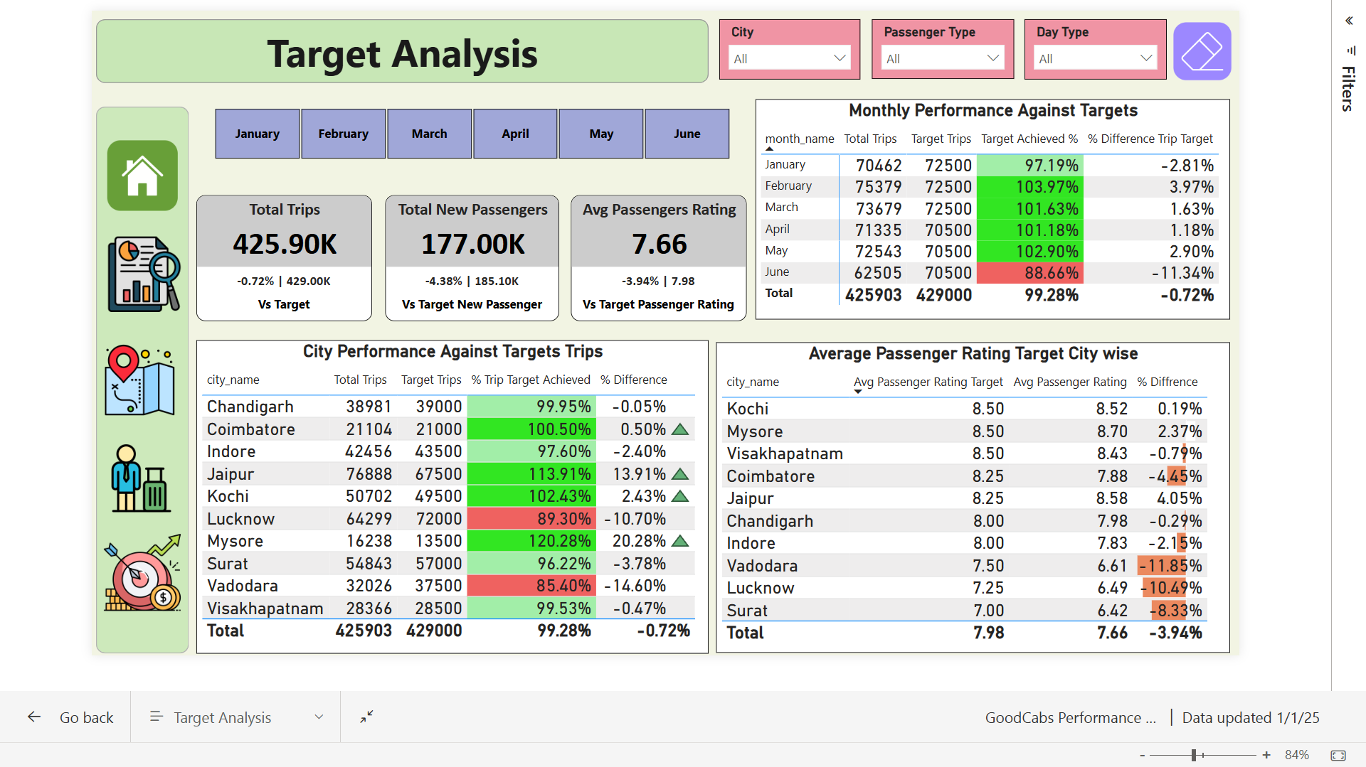

Slide 11
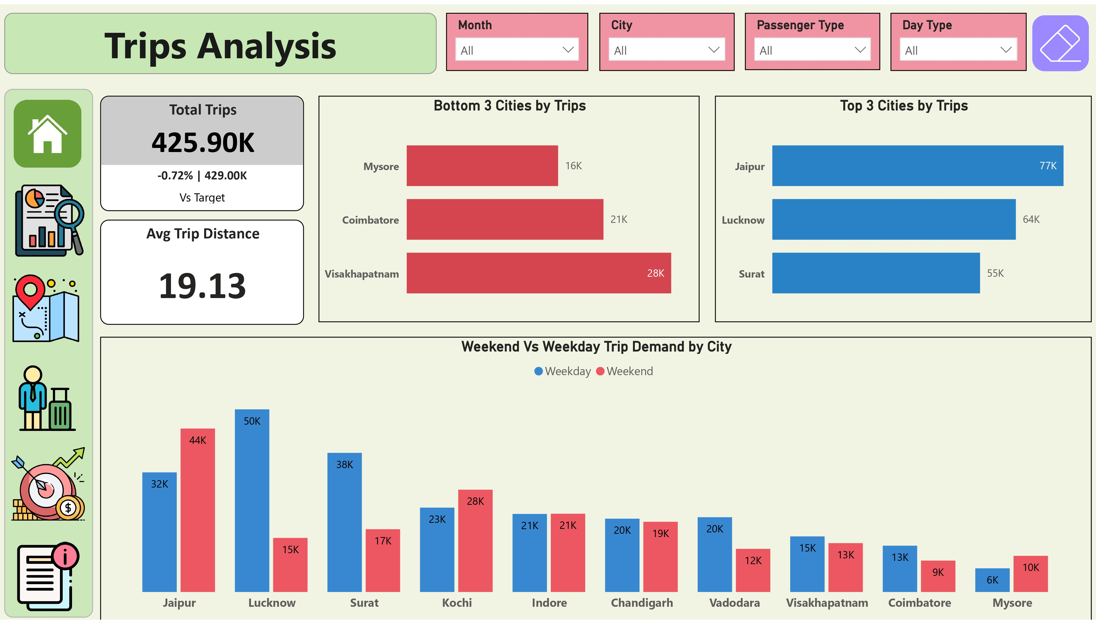
Top and Bottom Performing Cities
Key Insights:
Top-performing cities: Jaipur, Lucknow, Surat.
Bottom-performing cities: Mysore, Coimbatore, Vishakhapatnam.
Recommendation:
Focus on improving visibility and marketing efforts in Mysore, Coimbatore, and Vishakhapatnam to boost trip volume.
Enhance services and partnerships in Jaipur, Lucknow, and Surat to sustain growth.

Slide 12
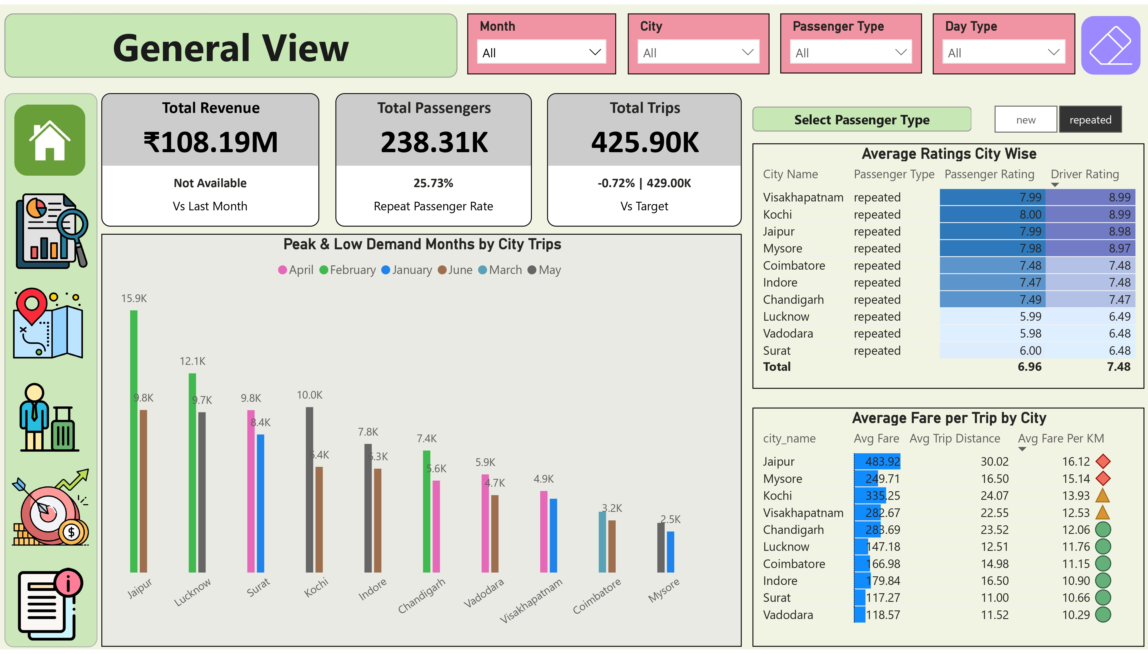
Average Fare per Trip by City
Key Insights:
Highest Average Fare: Jaipur, Kochi.
Lowest Average Fare: Surat, Vadodara. Recommendation:
High-fare cities: Maintain pricing strategy by ensuring high service quality.
Low-fare cities: Explore opportunities for upselling or introducing premium services to increase revenue.

Slide 13
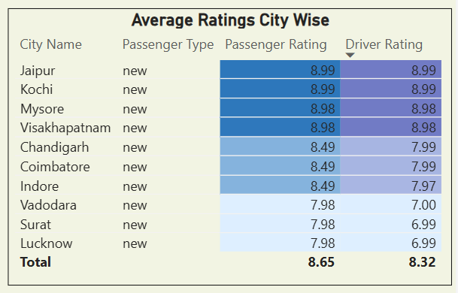
Average Ratings by City and Passenger Type
Key Insights:
Lowest Passenger and Driver Ratings: Lucknow, Vadodara, Surat, especially among repeat trips.
Recommendation:
Analyze feedback from passengers and drivers to identify issues.
Implement targeted training programs for drivers and service improvements to enhance ratings.

Slide 14
Peak and Low Demand Months by City
Key Insights:
Peak Demand Months:
February: Jaipur, Lucknow, Chandigarh.
May: Kochi, Indore, Mysore.
April: Surat, Vadodara, Vishakhapatnam.
March: Coimbatore.
Recommendation:
Plan resource allocation and marketing campaigns around peak and low-demand months.
Consider promotions or partnerships during low-demand periods to drive growth.
Low Demand Months:
June: Jaipur, Kochi, Indore, Vadodara, Coimbatore.
January: Surat, Vishakhapatnam, Mysore.
April: Chandigarh.
May: Lucknow.

Slide 15
Weekend vs. Weekday Trip Demand by City
Key Insights:
Higher Weekend Trip Demand: Jaipur, Kochi, Mysore.
Higher Weekday Trip Demand: Lucknow, Surat, Vadodara, Vishakhapatnam, Coimbatore.
Balanced Demand: Indore, Chandigarh.
Recommendation:
Weekend-focused cities: Develop tourism packages and weekend-specific promotions.
Weekday-focused cities: Enhance services for business travelers and commuters.

Slide 16
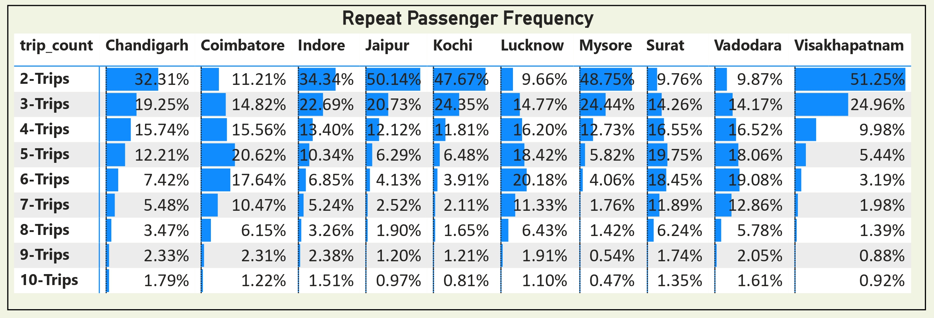
Repeat Passenger Frequency and City Contribution
Key Insights:
Coimbatore, Lucknow, Surat, and Vadodara have more repeat passengers with higher trip frequencies Recommendation:
Repeat passengers: Introduce loyalty programs to retain high-frequency travelers.
New passengers: Leverage digital marketing to attract more first-time users.

Slide 17
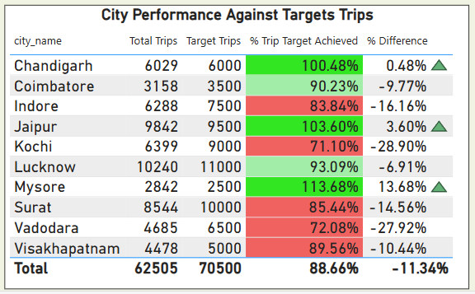
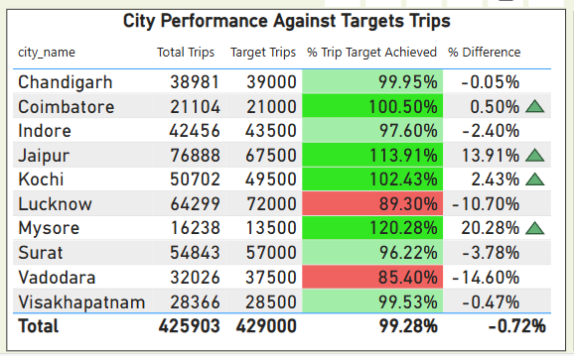
Monthly Target Achievement Analysis
Key Insights:
Underperforming Cities (Less than 90% of Target): Vishakhapatnam, Vadodara, Surat, Kochi, Indore, in June.
Overachievers (100%+ of Target): Coimbatore, Jaipur, Kochi, Mysore (Mysore achieved 120%).
Consistent Performers (95%+ of Target): Chandigarh, Indore, Surat, Vishakhapatnam.
Improvement Needed: Lucknow, Vadodara underperformed against target, including passenger ratings.
Recommendation:
For underperforming cities: Focus on improving trip volume and passenger ratings through targeted campaigns and operational improvements.
Leverage the strategies of overachieving and consistent cities as benchmarks for underperforming locations.
Notes:
Notable overachievers include Mysore and Jaipur, with Mysore exceeding 120% of its target! However, cities like Lucknow and Vadodara require focused campaigns to improve trip volumes and ratings.

Slide 18
Ad-Hoc SQL Report
Generated SQL reports to answer business-critical questions, including:
City-Level Fare and Trips Summary Report.
Monthly City-Level Trips Target Performance Report.
City-Level Repeat Passenger Trip Frequency Report.
Identify Cities with Highest and Lowest New Passengers.
Identify Month with Highest Revenue for Each City.
Monthly Repeat Passenger Rate Analysis.
City Repeat Passenger Rate Analysis.

Slide 19
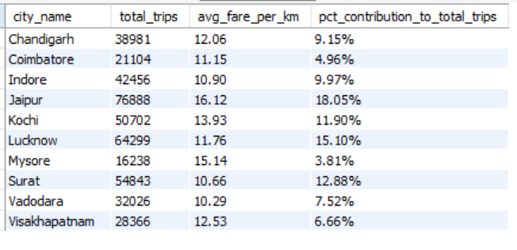
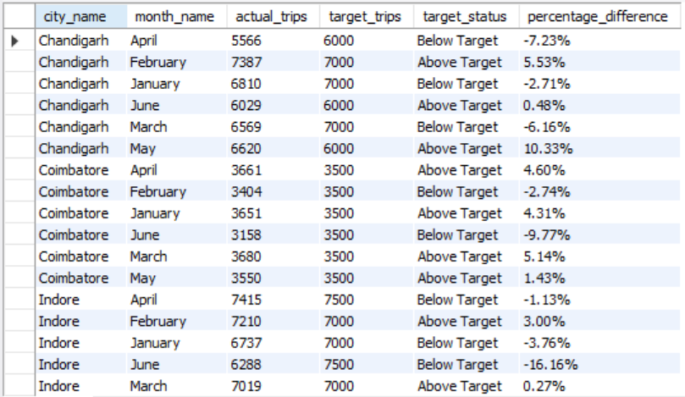
Ad-Hoc SQL Report
City-Level Fare and Trips Summary Report
Monthly City-Level Trips Target Performance Report

Slide 20
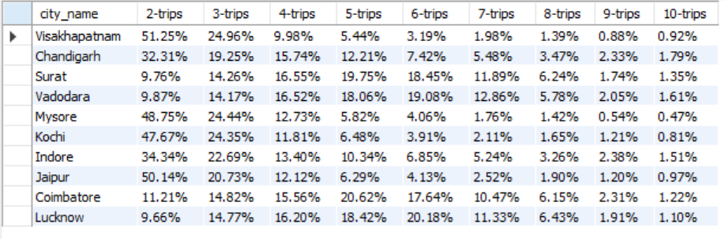
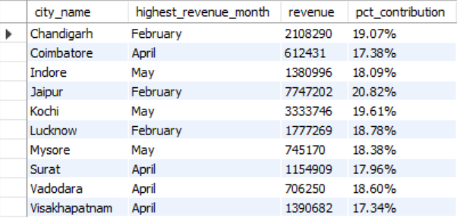
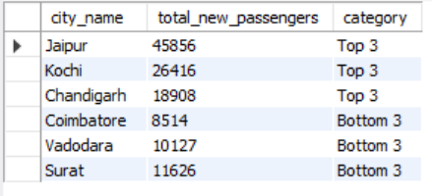
Ad-Hoc SQL Report
City-Level Repeat Passenger Trip Frequency Report
Identify Month with Highest Revenue for Each City
Identify Cities with Highest and Lowest New Passengers

Slide 21
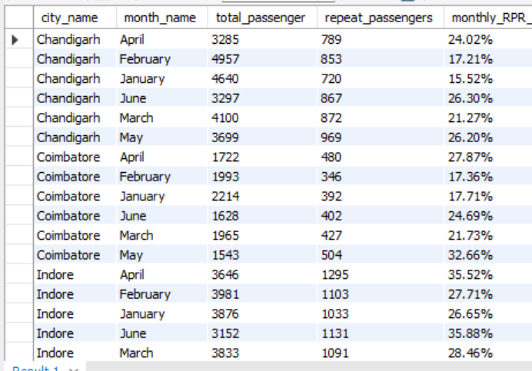
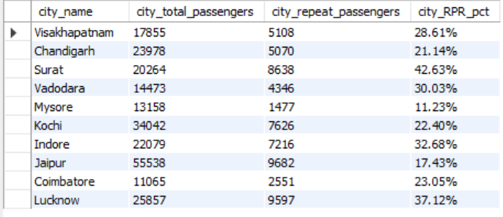
Ad-Hoc SQL Report
Monthly Repeat Passenger Rate Analysis
City Repeat Passenger Rate Analysis

Slide 22
Action Plan and Next Steps
> Business-Centric : For top-performing weekday cities like Lucknow, Surat, and Jaipur, Goodcabs should partner with companies and employers to provide regular services, ensuring consistent usage during workdays. > Tourism-Centric : For weekend-focused cities like Jaipur, Kochi, and Indore, which are tourism-centric, collaboration with local businesses like hotels and resorts for tourist packages can help attract more passengers during peak times. > Eco-friendly Initiatives: Adopting electric vehicles (EVs) and promoting eco-friendly practices will enhance Goodcabs' reputation as a sustainable brand. This will attract environmentally conscious customers and allow for targeted green marketing campaigns to gain a competitive edge. > Data Collection for Analysis: To improve services, Goodcabs should collect data such as customer satisfaction ratings, driver performance metrics, city-wise driver availability, trip cancellations and their reasons, and details on city-wise promotions and advertisements. This data will support better analysis and more informed recommendations.
Notes:
Thank you for joining this analysis of GoodCabs’ performance. Together, we can help GoodCabs drive growth, improve customer satisfaction, and achieve its ambitious 2024

Slide 23
Thank You

